Slide 1

Memory Access Cycle and
the Measurement of Memory Systems
Xian-He Sun
Dawei Wang
November 2011

Slide 2
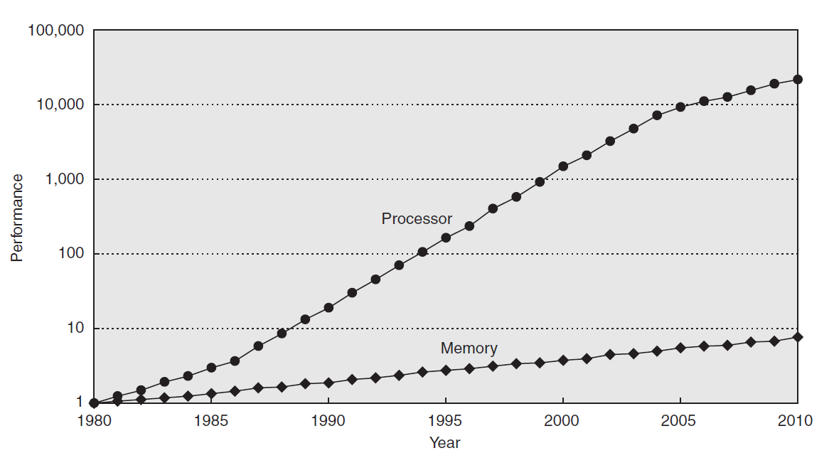
Memory Wall Problem
Processor-DRAM Memory Gap
µProc 1.20/yr.
“Moore’s Law”
µProc 1.52/yr.
(2X/1.5yr)
DRAM
7%/yr.
(2X/10 yrs)
Processor-Memory
Performance Gap:
(grows 50% / year)
1980: no cache in micro-processor; 2010: 3-level cache on chip, 4-level cache off chip
1989 the first Intel processor with on-chip L1 cache was Intel 486, 8KB size
1995 the first Intel processor with on-chip L2 cache was Intel Pentium Pro, 256KB size
2003 the first Intel processor with on-chip L3 cache was Intel Itanium 2, 6MB size
Source: Computer Architecture A Quantitative Approach
Notes:
CPU 1986~2005 1.52/yr, 2005~now 1.20/yr
A metaphor from get a reply from a friend cost you half an year
486 http://en.wikipedia.org/wiki/Intel_80486
Pentium Pro http://en.wikipedia.org/wiki/Pentium
Cache http://en.wikipedia.org/wiki/CPU_cache

Slide 3
Extremely Unbalanced Operation Latency
IO Access 5~15M cycles
Cycles

Slide 4
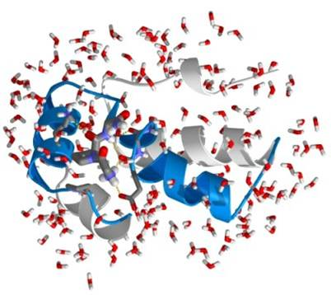
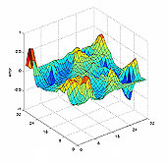
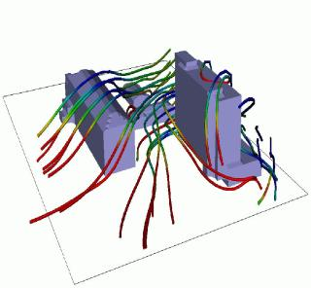
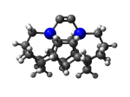
Data Access becomes THE Bottleneck
Applications become data intensive
  Animation and Visualization applications
  Data mining, information retrieval
  Geographic information system, etc
  Scientific and engineering simulation
Need a better understanding of memory system performance
Need a new performance metric for memory systems
Source: Gromacs
Source: Multi-grid solver
Source: MPQC
Source: NaSt3DGP
Notes:
In the meantime, applications tend to be data intensive, such as …
These applications vary widely in their data-access characteristics. These data-intensive applications often exhibit different access patterns, and many accesses are small, non-contiguous and periodic.
These diverse application features should be well considered in order to deal with .. bottleneck.
CFD: computational fluid dynamics simulation
Multi-Grid solver: an approach for CFD
Gromacs: is a molecular dynamics simulation package
NaSt3DGP - A Parallel 3D Flow Solver
MPQC: is the Massively Parallel Quantum Chemistry Program.

Slide 5
Complexity of Memory Hierarchy
Capacity
Access Time, Bandwidth
Staging
Xfer Unit
Upper Level
faster
CPU Registers
<8KB
<0.2~0.5 ns, 500~800 GB/s/core
Registers
Instr. Operands
prog./compiler
1-8 bytes
Cache
<50MB
1-10 ns, 50~150GB/s/core
Cache
Blocks
cache cntl
32-128 bytes
Main Memory
Giga Bytes
50ns-100ns 5~10GB/s/channel
Memory
Pages
OS
4K-4M bytes
Disk
Tera Bytes, 5 ms
100~300MB/s
Disk
Files
user/operator
Mbytes
Tape
Peta Bytes or infinite
sec-min
Larger
Tape
Lower Level
Notes:
10% global miss

Slide 6
Complexity of Data Access
The complexity of CPU Design
  Out-of-order Execution
  Multithreading technology
  Speculation mechanisms
The complexity of Memory Design
  Advanced Cache Technologies
  Allow tens or hundreds of cache accesses to overlap with each other
  Processor continue execution instructions under multiple cache misses
Notes:
The CPU ILP technologies with many parallelism and speculation make the traditional memory performance metrics cannot directly characterize the finally application.

Slide 7
Existing Memory Metrics
Miss Rate(MR)
  {the number of miss memory accesses} over {the number of total memory accesses}
Misses Per Kilo-Instructions(MPKI)
  {the number of miss memory accesses} over {the number of total committed Instructions × 1000}
Average Miss Penalty(AMP)
  {the summary of single miss latency} over {the number of miss memory accesses}
Average Memory Access Time (AMAT)
  AMAT = Hit time + MR×AMP
Flaw of Existing Metrics
  Focus on a single component or
  A single memory access
Notes:
Deficiency of traditional memory metric
only reflect the proportion of the data in or out of the cache
don't reflect the penalty of the miss access
Only consider miss information
Measured based on single access, ignoring the concurrency of accesses

Slide 8
Measure Memory Performance:
The Requirements
Separate but closely related to CPU performance
  Not Flop or IPC, but a major factor
Provide the total performance of the memory system as well as the performance of each tier of the memory hierarchy
Cover the complexity of modern memory systems
Simple, easy to use, and easy to understand

Slide 9
The Introduction of APC
Access Per Cycle (APC)
APC is measured as the number of memory accesses per cycle
  Measures the overall memory system performance
  Each memory level has its own APC value
  Dominating overall CPU performance
Benefits of APC
  Separate memory evaluation from CPU evaluation
  A better understanding of memory system as a whole
  A better understanding of the match between computing capacity and memory system performance
Notes:
IPC, Flops are designed to measure CPU performance
MR, MPKI, and AMAT are based on one component or single access point of view
Based on the similarity between processors and memory systems, inspired by the success of IPC, APC is proposed.

Slide 10
APC in Detail
APC is the overall memory accesses requested at a certain memory level (i.e. L1, L2, L3, Main Memory) divided by the total number of memory access cycles at that level
  APC = M/T
  Different level has different APC
    APC_{D} L1 Data Cache
    APC_{I} L1 Instruction Cache
    APC_{M} Main Memory
APC performance is hierarchical
Notes:
Different level has its own APC values

Slide 11
APC Measurement
The difficulty is measuring the total cycle T
  Hundreds of memory accesses co-exist the memory system
Measure T based on the overlapping mode
  When there are several memory accesses co-existing during the same clock cycle, T only increases by one
  Measure the concurrence
  Measure the concurrence at each level
Notes:
Different level has its own APC values

Slide 12
APC Measure Logic (AML)
Detects memory access activities from MSHR, cache and CPU
If one active, Cycle ++
Hardware cost analyze
  CPU/Cache interface detecting logic<=bit-width of the command and data buses
  Cache detecting logic = length of the pipeline stage of cache access
  MSHR table empty status, 1bit
  Total less than 1K bits
Notes:
Structure of AML, and its hardware cost

Slide 13
APC_{M} Measurement
Last Level Cache Measurement
  DRAM Accesses Count
  LLC MSHR Cycles
  APC_{M} = DRAM Accesses Count / LLC MSHR Cycles
Hardware cost
  DRAM Access Count usually provided by CPU performance counters
  LLC MSHR Cycles only need 1 bit to detect MSHR empty or not
  Available on some microprocessors

Slide 14
Validation Testing Methodology
System performance is the ultimate interest
A good memory metric should influence system performance directly
Use IPC (Instruction Per Cycle) as the system performance
Use Correlation Coefficient to measure the correlation
  Better correlation, better metric

Slide 15
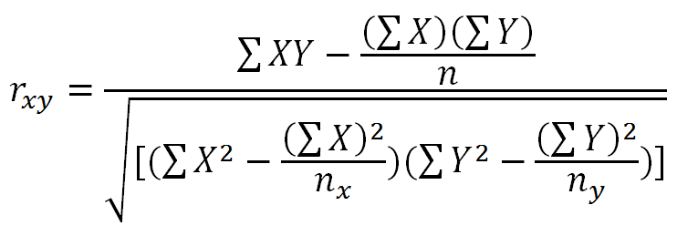
Correlation Coefficient
Correlation coefficient (CC) describes the proximity between two variables changing trends from a statistics viewpoint.
It measures how well two variables match with each other
Range | Relation
1, -1 | Perfectly Match
≥ 0.9 | Dominant relation
≥ 0.8 | Strong relation
≥ 0.5 | Weak relation
0 | No relation

Slide 16
Experiment Environment
Detailed out-of-order Alpha 21264-like CPU model in the M5 simulator
  Superscalar: out-of-order, speculation, 8-issue
  Private split L1 caches + Shared L2 cache
  Non-blocking cache, pipelined cache, cache prefetching
  Single core & Multi-core
Simulate a serial of configurations with changing one or two memory parameters
Spec CPU2006, 26 benchmarks, 1B instructions
Test on different configurations & benchmarks

Slide 17
Default Simulation Configuration
Parameter | Value
Processor Function units ROB, LSQ size | 1core, 2 GHz, 8-issue width, 6 IntALU 1 cycle, 1 IntMul 3 cycles, 2 FPAdd 2 cycles, 1 FPCmp 2 cycles, 1 FPCvt 2 cycles, 1 FPMul 4 cycles, 1 FPDiv 12 cycles ROB 192, LQ 32, SQ 32
L1 caches | 32KB Inst/32KB Data, 2-way, 64B line, hit latency: 2 cycle Inst/2 cycle Data, ICache 10 MSHR Entry, DCache 10 MSHR Entry
L2 cache | 2MB, 8-way, 64B line, 12-cycle hit latency, 20 MSHR Entry
DRAM latency/Width | 200-cycle access latency/64 bits

Slide 18
A set of Simulation Configurations
ID | Description | Changed Parameter/s
C1 | L1:32KB,2way; L2: 2MB,8way; Mem100ns | Default Config
C2 | L1:32KB,4way; L2: 2MB,8way; Mem100ns | L1 Cache Assoc.
C3 | L1:32KB,8way; L2: 2MB,8way; Mem100ns | L1 Cache Assoc.
C4 | L1:64KB,2way; L2: 2MB,8way; Mem100ns | L1 Cache Size
C5 | L1:64KB,4way; L2: 2MB,8way; Mem100ns | L1 Cache Size & Assoc.
C6 | L1:64KB,8way; L2: 2MB,8way; Mem100ns | L1 Cache Size & Assoc.
C7 | L1:I$32KB,2way, D$64KB,2way; L2: 2MB,8way; Mem100ns | Only DCache Size
C8 | L1:I$64KB,2way, D$32KB, 2way; L2: 2MB,8way; Mem100ns | Only ICache Size
C9 | L1:I$64KB,4way, D$32KB, 2way; L2: 2MB,8way; Mem100ns | Only ICache Size & Assoc.
C10 | L1:I$64KB,8way, D$32KB, 2way; L2: 2MB,8way; Mem100ns | Only ICache Size & Assoc.
C11 | L1:32KB,2way; L2: 4MB,8way; Mem100ns | L2 Cache Size
C12 | L1:32KB,2way; L2: 8MB,8way; Mem100ns | L2 Cache Size
C13 | L1:32KB,2way; L2: 2MB,16way; Mem100ns | L2 Cache Assoc.
C14 | L1:32KB,2way; L2: 4MB,16way; Mem100ns | L2 Cache Size & Assoc.
C15 | L1:32KB,2way; L2: 8MB,16way; Mem100ns | L2 Cache Size & Assoc.
C16 | L1:32KB,2way; L2: 2MB,8way; Mem30ns | Main memory latency
C17 | L1:32KB,2way; L2: 2MB,8way; Mem60ns | Main memory latency
C18 | L1:32KB,2way, MSHR 1; L2: 2MB,8way; Mem100ns | MSHR Entry
C19 | L1:32KB,2way, MSHR 2; L2: 2MB,8way; Mem100ns | MSHR Entry
C20 | L1:32KB,2way, MSHR 16; L2: 2MB,8way; Mem100ns | MSHR Entry
Notes:
There are three groups of configurations. The first group, including configuration C1~C17, are the basic cache/memory configurations, which only change the cache size or associativity, or memory latency. These basic configurations have 10 MSHR entries each. C18~C23 are the advanced cache configurations, which consider effect of non-blocking cache and prefetcher structure. C18~C20, which compose the second group, add Stride Prefetcher to L1 data and instruction cache with different prefetching degree, 1, 2 and 4 respectively. The third group, which consists of configuration C21~C23, changes the memory access parallelism by changing the number of MSHR entry. The C21 changes the cache model into a blocking cache structure, which means the number of MSHR entry is only 1. C22 and C23 increase the MSHR entry to 2 and 16 respectively.

Slide 19
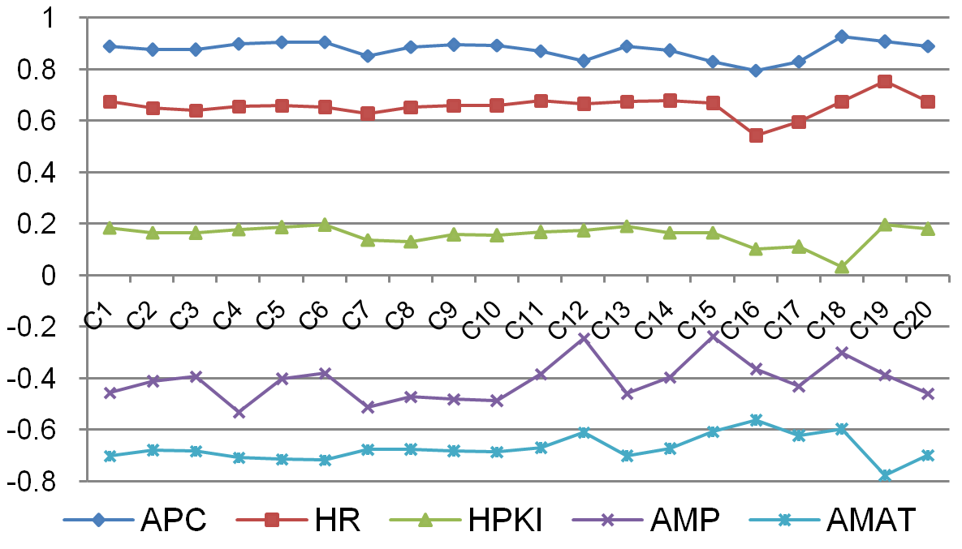
APC and IPC with Different Applications
APC has the strongest relation with IPC (CC = 0.871)
AMAT is the second best with average CC value of -0.670
APC improves correlation value by 30.0%
HR has almost the same correlation value with AMAT
Notes:
Introduce 5 memory metrics, and there CC value should be positive or negative

Slide 20
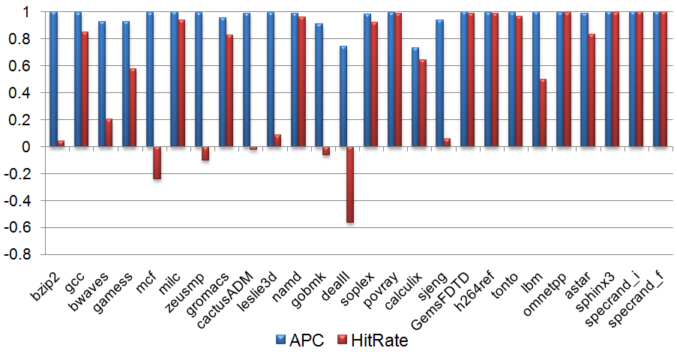
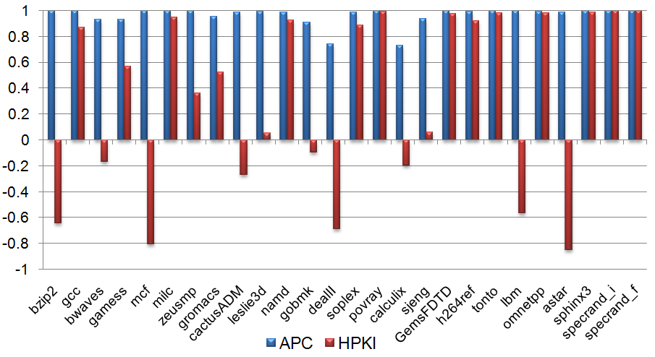
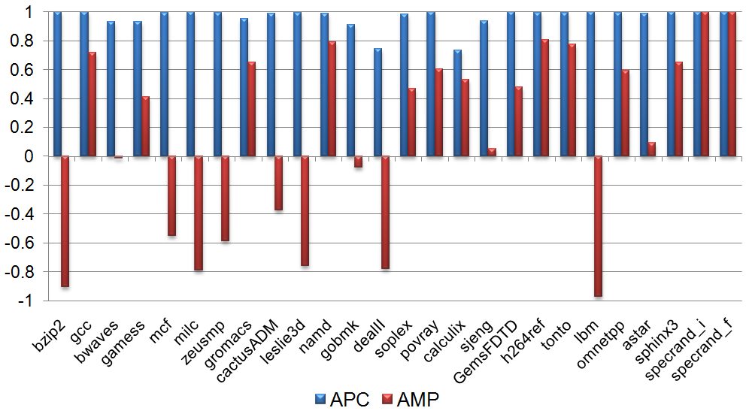
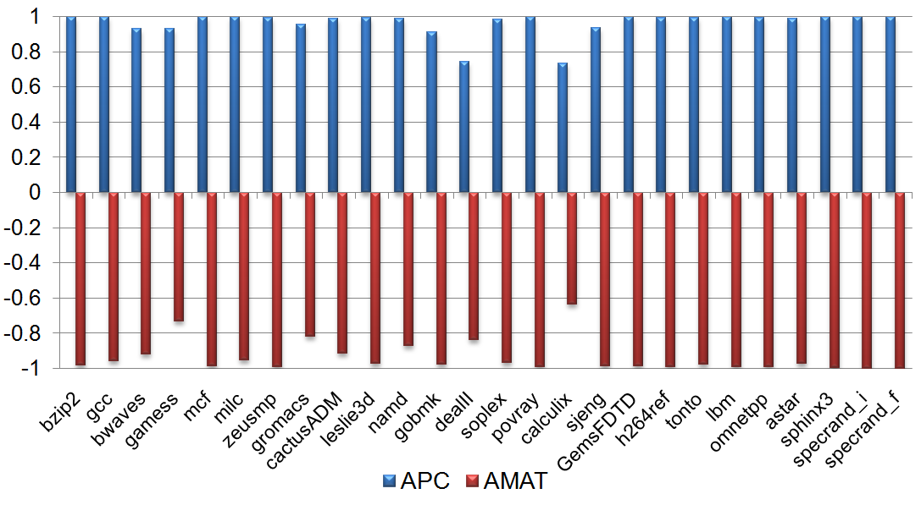
APC & IPC with Different Configurations
Notes:
APC, HR, H1KInst should have positive correlation coefficient values since the higher these values are, the higher memory performance is, therefore the IPC should be improved. AMP and AMAT should have negative correlation coefficient values since the higher these values are, the lower memory performance is, therefore the IPC should decrease.

Slide 21
Experiments Results
APC has the highest correlation coefficient value with IPC, the average value for all application is 0.9632
  APC and IPC has a directly dominant relationship
AMAT has the second highest correlation with IPC, with an average value of -0.9393
  AMAT is a pretty good metric in reflecting memory performance variation without considering Non-blocking cache optimization
For other metrics, there are some misleading indications

Slide 22
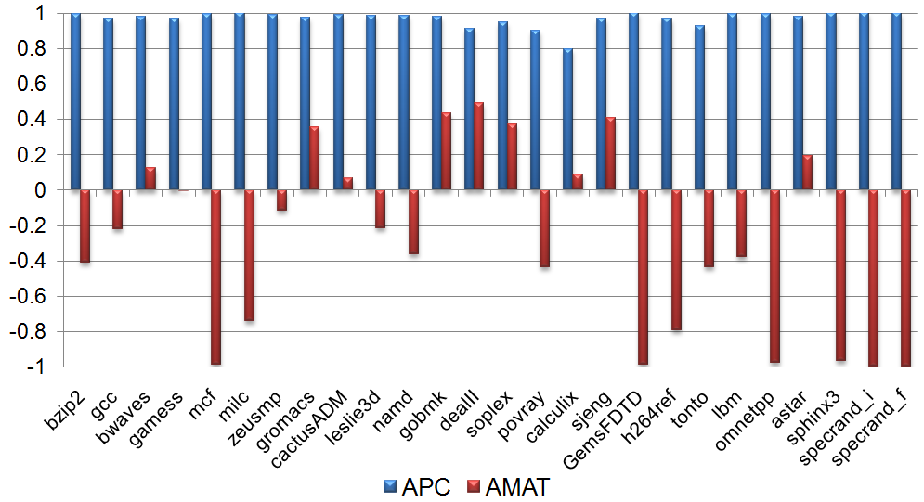
APC & IPC: Changing Cache Parallelism
Changing the number of MSHR entries (1→2→10→16)
APC still has the dominant correlation, with average value of 0.9656
AMAT does not correlate with IPC for most applications
  APC record the CPU blocked cycles by MSHR cycles
  AMAT cannot records block cycles, it only measure the issued memory requests
Notes:
All case, basic configuration change+ hardware prefetching + mshr changes (C1~C23)

Slide 23
Exhausted Testing
With different benchmarks, and with different configurations
With advanced cache technologies
  Non-block cache
  Pipelined cache
  Multi-port cache
  Hardware prefetcher
With single core or multicore
APC always has the highest CC values among all the memory metrics

Slide 24
APC Applications
Find the lowest level that has a dominating correlation with IPC
Find the contribution of concurrence
Quantitatively define data intensiveness
Provide a mean to study the matching between memory organization and microprocessor architecture,
Provide a mean to study the matching between memory organization and a given application

Slide 25
A Definition of Data Intensiveness
The IPC and APC correlation value provides a quantitative definition of data intensive
Use the correlation value of APC_{M} to quantify the degree of data intensive
  Do not count data re-use as part of data-intensiveness unless it has to be read from main memory again
  Assuming the "memory-wall" problem is actually due to the slow speed of main memory
  Could define differently for small kernel application or off-core application
Definition
coe(APC_{M}, IPC) ≥ 0.9

Slide 26
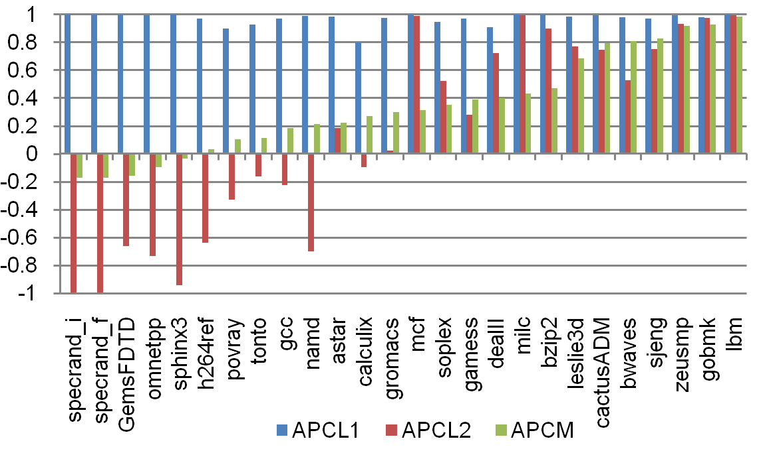
Data-intensive Definition
The correlation value of APC_{M} are divided into three intervals, that is (-1, 0.3), [0.3, 0.9), [0.9, 1)
Reason for picking 0.9 as the threshold
  According to mathematical definition of correlation coefficient
  When CC >= 0.9, then the two variables have a dominant relation
Notes:
It can be concluded that the application performance of these 13 applications are dominated by the L1 cache, not L2 or main memory. Because the correlation values of APC_{L2} and APC_{M} of these applications are negative or very small, As the correlation value of APC_{M} increases, the effect of main memory to the overall application becomes more and more important. Therefore, in the second interval (from mcf to sjeng), some applications' performance are dominated by the L2 caches, e.g. mcf, milc. While for some others applications, such as bzip2, L2 and main memory are both important. For the third interval, the applications' performances are dominatingly determined by main memory performance.

Slide 27
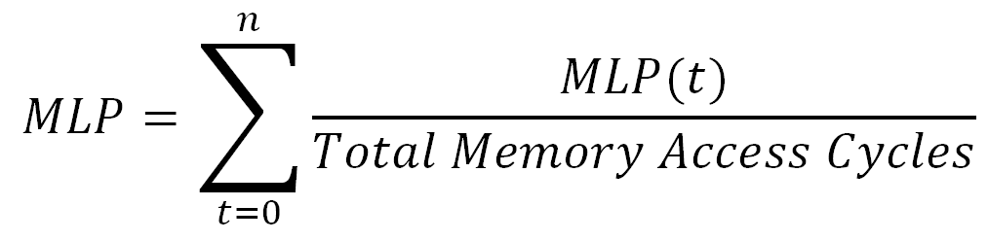
Related Work
Traditional Memory Metrics
  Miss Rate (MR), Miss Per Kilo-Instructions (MPKI),
  Average Miss Penalty (AMP), Average Memory Access Time (AMAT)
Memory Level Parallelism (MLP)
  Average number of long-latency main memory outstanding accesses when there is at least one such outstanding access
  Assuming each off-chip memory access has a constant latency, say m cycles, APC_{M}=MLP/m
  That means APC_{M} is directly proportional to MLP
  APC is superset of MLP

Slide 28
Conclusion
Contribution
  Proposed new memory metric APC
  APC links memory performance to CPU performance
  APC links the performance of each tier of a memory hierarchy together
Future Work
  Extend to file system APC_{IO}
  Extend to network environment APC_{Net}
  Measure APC_{M ,} APC_{IO ,} and APC_{Net}
  Use APC to analyze the bottleneck of data-centric algorithms

