Slide 1
Career in Graduate School and Beyond:
A Random Walk
Xian-He Sun
April 6， 2015
Illinois Institute of Technology
Chicago, Illinois
sun@iit.edu
Based on collected slides from IIT, Berkeley and UIUC
Notes:
This talk is on the scalability of multicore architecture.
The “scalability” refers to the capability of a system how well it can maintain the performance at a large-scale size compared to a small-scale size. A quick example: plain text file v.s. database solution for storing contact information with tens of thousands scale. In this talk, the “scalability” discussion is in the context of machine architecture.
--

Slide 2
Outline
Education and Research
Career in Graduate School
How to Conduct Research (Engineering)
Career after Graduate School

Slide 3
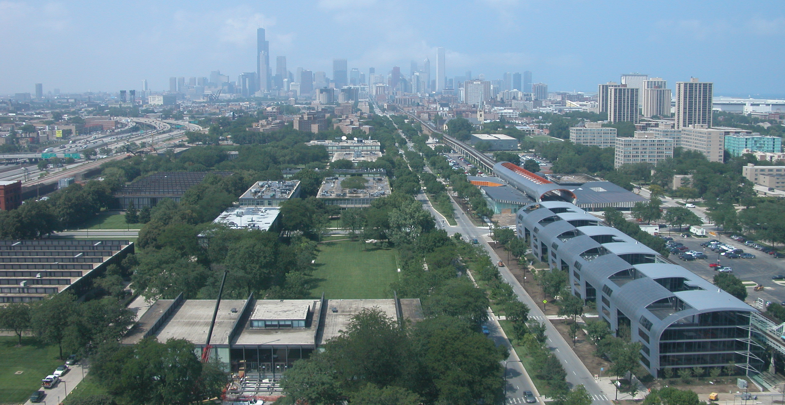
Welcome to the 21st Century IIT.
Real world rigor since 1890

Slide 4

Founded “to help young people help themselves”
Grants Bachelor’s, Master’s, J.D., Ph.D.
Member, Association of Independent Technology Universities
Accredited by NCA, ABET, ABA, APA, AACSB
Real world rigor since 1890

Slide 5
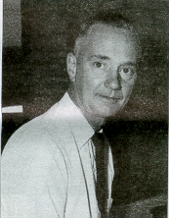
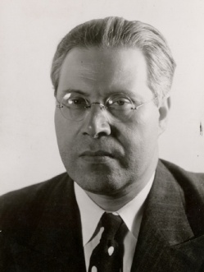

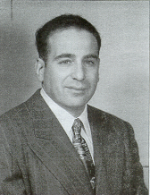
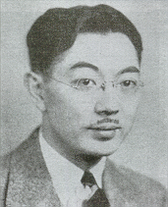
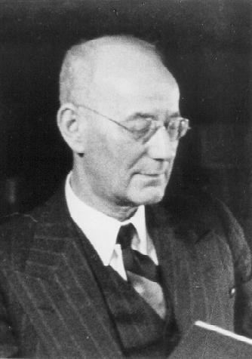
Path-breaking Intellectual Tradition
Grote Reber
Radio Telescope
Laszlo Moholoy-Nagy
The New Bauhaus
Ludwig Mies van der Rohe
Chicago School Architecture
Marvin Camras
National Medal of Technology
Magnetic Recording
S.I. Hayakawa
Semanticist
Max Jakob
Thermo Dynamics & Heat Transfer
Notes:
Some of the famous faculty.
Note: Marvin Camras, inventor of magnetic recording, was also a graduate of IIT’s electrical engineering department and earned more than 500 patents. He received the National Medal of Technology

Slide 6
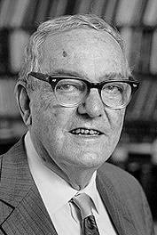
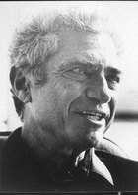
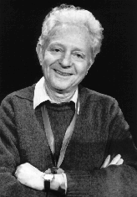
Intellectual Leadership
Nobel Laureates
Herbert Simon
Nobel Prize
Economics
Jack Steinberger
Nobel Prize
Physics
Leon Lederman
Nobel Prize
Physics

Slide 7
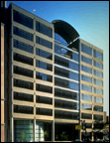
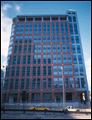
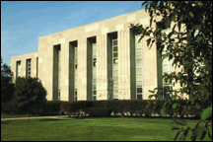
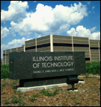
Chicago area campuses
Main Campus
Downtown Campus
Institute of Design
Moffett Campus
Rice Campus Wheaton

Slide 8
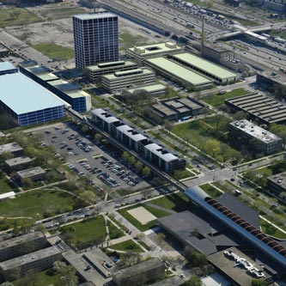
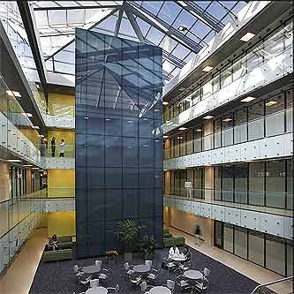
University Technology Park on Campus
Tech business incubator
Faculty/student enterprises and others
Laboratory and office space
Nationally renowned contract research organization (IITRI)
Moving Innovation forward

Slide 9
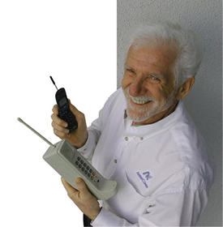
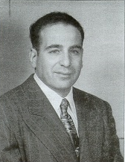
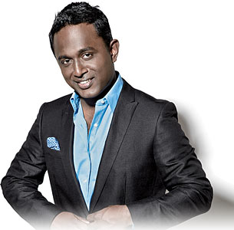
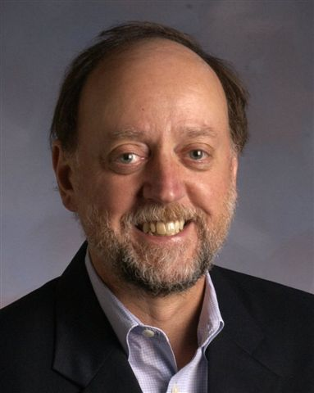
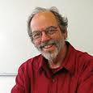
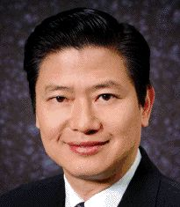
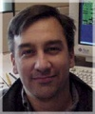

Innovation
Path-breaking Intellectual Tradition
Marvin Camras
National Medal of Technology
Magnetic Recording
Father of Cell Phone Martin Cooper
Biju Kulathakal
co-founder, Redbox, IIT90s
Jack Dongarra
Member NAE
CS73
Victor Tsao
Founder: Linksys
CS80
Ward Cunningham
Founder, Wikis, IS60s
Abdur Chowdhury
Chief Scientist, CS01
Information Program in 1950s, Computer Science Department in 1971
Notes:
Some of the famous faculty.
Note: Marvin Camras, inventor of magnetic recording, was also a graduate of IIT’s electrical engineering department and earned more than 500 patents. He received the National Medal of Technology

Slide 10
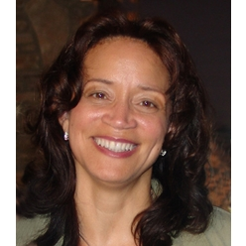
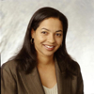
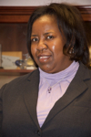
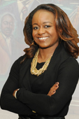
Path-breaking Intellectual Tradition
Education
Girls Computing Camp
Interprofessional Program
International Institute
Sherrie Littlejohn
Executive VP
Wells Fargo, MS CS82
Andrea Berry Senior VP,
Fox Networks
CS 84
Loretta Moore, Chair
Jackson State University
MS CS86, Ph.D. CS '91
Cheryl Hyman, Chancellor
City Colleges of Chicago
MS CS96
15,000 high school students and 1,200 teachers were trained before 1971
6,000 CS degree granted since 1971

Slide 11
Mission
To advance knowledge through research and scholarship,
to cultivate invention improving the human condition, and
to educate students from throughout the world for a life of professional achievement , service to society, and individual fulfillment.
Notes:
Honed and rededicated the university’s mission

Slide 12
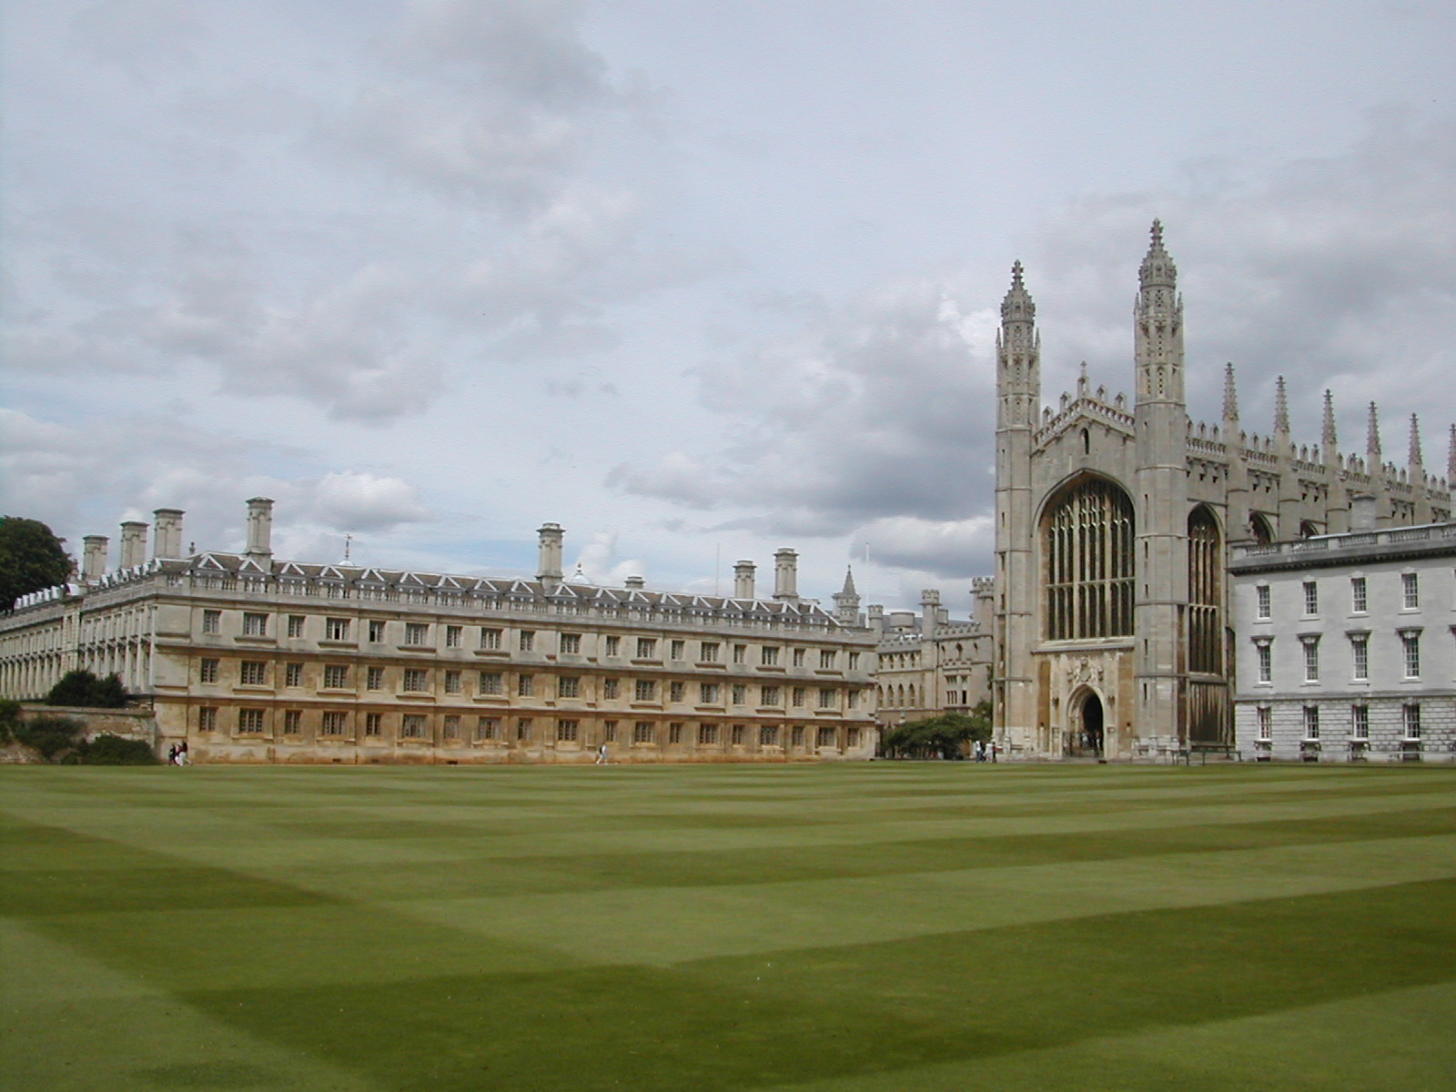
Mission
“True” universities: Elite, training
for thinkers, but not skill

Slide 13

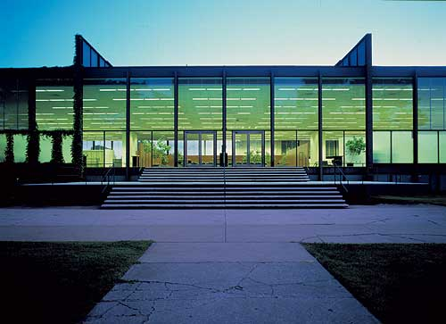


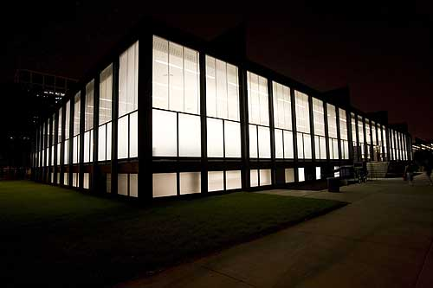
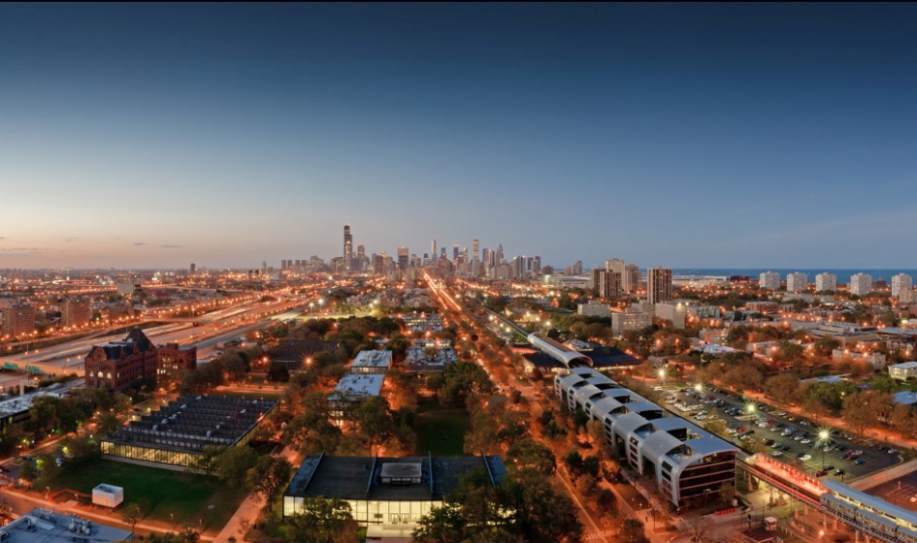
Most Success Technologies are Pervasive
Innovation
Technology Driven

Slide 14
Graduate School
The Jumping Pad

Slide 15
Research
Theoretical and Experimental Engineering
Research Impact
Being a scientist, our goal is to lift the wisdom of human beings. Being an engineer, our goal is to improve the quality of life of human society.
Paper is the result of research. Paper is not the purpose of research. In other words, writing papers is to introduce your research results, research is not measured in the number of papers.
Xian-He Sun

Slide 16
Research
Theoretical and Experimental Engineering
Research Impact
基础科学的研究影响力主要表现在拓广了人类对世界的认识；工程项目的研究影响力主要表现在提高了人类生活的质量
文章是研究的结果，文章不是研究的目的。换句话说。 写文章是让他人了解你的科研成果，研究不是为了写文章。
Xian-He Sun

Slide 17
Illusion of Graduate Career
Concentrate on getting good grades?
  Reality: need to maintain reasonable grades
    Need to pass the qualify exams
  What matters on graduation is your record of achievement and letters of recommendation
Concentrate on graduating as fast as possible?
  Your last chance to learn; most learning will be outside the classroom
  Can you land and be successful on a position you prepared for?

Slide 18
Illusion of Graduate Career
Only work the number of hours per week you are paid?
  Faculty average works 65-70 hours
  Students should be in that range
  Organize each day: when most alert? nap? exercise? sleep?
  To do lists: daily, weekly, semester
  Enjoy what you do
Don’t listen to your advisor?
  You may be smart, but the advisor is more experienced
  Faculty career is judged in large part by success of their students

Slide 19
Illusion of Graduate Career
Stay home to avoid distractions?
  Need to interact to get great ideas
Don’t go to conferences?
  Chance to see firsthand what the field is like, where its going
  Talk to people in the field in the halls
Don’t waste time polishing writing or talks?
  The more polish the more likely people will pay attention to your ideas
  Adequate Communication skill is a must
  Not how much you write, but what people remember

Slide 20
Successful Graduate Students
3 observations (Remzi Arpaci )
1) “Swim or Sink”
  “Success is determined by student primarily”
  Faculty will set up the opportunity, but its up to the student leverage it
2) “Read/learn on your own”
  “Fast moving field, don’t expect professor to be at forefront everywhere”
3) “Teach your advisor”
  “I really liked this concept; go out and learn about something and then teach the professor”

Slide 21

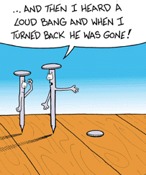
Conduct Research
Approach
Build Strong Hammer (skill)
Find nails
Find the nail (topic)
Select appropriate hammer
  Comprehensive analysis
  Stochastic/Statistics
  Data Mining/Machine Learning
  Simulation

Slide 22
Research Methodology for
Problem-Driven Research
Phase 0: Research Topic Identification
  It is an ART
  Ask, Read, & Think
Motivation
Challenges
Contribution
Key point

Slide 23
Problem-Driven Research Process(1)
Phase 1: Problem space understanding
  From high level to low level
  Identify a concrete, important, open problem
    Understand the motivation and importance of the problem
    Problem may also come from your own experience and insight
    Literature study to get the state of the art to make sure it is open
  Concrete examples examination
  Matching the goal and strength of you and your group

Slide 24
Problem-Driven Research Process(2)
Phase 2: Solution Seeking
  Think, Brainstorm, Try
Phase 3: Feasibility Study
  Fast Prototype
  Simple Statistic Collection
  Manual idea walk through concrete examples
Phase 4: If feasible, thoughts synchronization
  Write introduction and related work
  Determine selling points
  Determine major research challenges

Slide 25
Problem-Driven Research Process(3)
Phase 5: System and experiment design
  Put design and experiment design in paper
  Draw empty figures in paper
  Determine which system to build on & which applications to use
Phase 6: Implementation
  Coding, debugging, testing, write implementation section
  May need to back to phase 3~5 to adjust design
  Changes are always recorded in writing

Slide 26
Problem-Driven Research Process(4)
Phase 7: Result Collection
  First need to know what result we shall expect
  System tuning
  Fill in results in paper
Phase 8: Proof read papers
  Ask others for feedback
  Wait for 1 week and read the paper again
  Don’t EVER argue with people who give feedback
    If they don’t understand it, it is YOUR fault
    You are not there to argue with reviewers and readers.

Slide 27
Some Suggestions
Base of idea
  Improve existing works
  Meet the current needs
Source of idea
  Read, think, participate discussion, and ask
  Interns at industry and research laboratories
Networking and group work
  Do not mind the order of authors
    Senior students guide junior ones→ help each other beyond graduation
  Do not care adding big guy as co-authors
    References from them are important

Slide 28
Essential Elements of a Good Paper
Motivation
Problem description
Important existing solution(s)
Description of your solution
Results
Analysis
Conclusion
Xian-He Sun

Slide 29
Some Suggestions
Three approaches to confirm your proposed solution
  Proof and analytical results
  Implementation and experimental testing
  Simulation results
  Use two of the three for cross confirmation
Emphasis on Motivation and Contribution
  Motivation for the importance of your problem
  Contribution for the importance of your solution
Clear and Right on the topic
  One theme
  Shorter is better
Xian-He Sun

Slide 30
Student Advising
Two standards for new students
  Ambitious, Self-Motivation
  Talk to Advisor
Reach all the potential
  Find each student’s strength
    Open questions for students to study
  1 senior student with 2-3 junior students
    From participate to independent, to lead
Advisor is Bei Liu (刘备)
  Leader is not strong
  Know everyone’s advantage and utilize them
  Point a right nail (hopefully), student conduct the hit with a hammer

Slide 31
Reading Meeting
Select Two Papers
  Follows most papers from conferences
  Choose related papers：
Presentation and discussion
  One presents
  Others perform as Program Committees (PC)
    Review: Ideas, Strength, Weakness,
    Grade the speaker!
Funny discussion
  Who is Top？-- Research Interest，member，achievement……
  Who is Who? –The stories behind leading researchers
    Research interest，achievement，Advisor and Students，etc.
  Conduct quiz periodically: especially before meetings

Slide 32
Meeting Student
Fruitful meeting
  Come with a problem
  No problem, no discussion, and therefore, no interaction and boring
Introduce weekly progress:
  Report what have done → work for the supervisor
    Could be a good or bad student based on what actual is done
  Bring in a problem → Self-motivated
  Bring in a solution → Moving to become a independent researcher

Slide 33
Role Change （转型）
Student
  Skill, build the hammer (or muscle)
Assistant Professor
  Nail and hammer
Associate Professor
  Supervise students
Professor
  Leadership
Technical Staff
Senior Technical Staff
Supervisor
Xian-He Sun

Slide 34
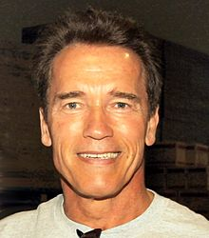



转型成功案例
Arnold Schwarzenegger
Xian-He Sun

Slide 35
Lead a Group
Vision
  Research direction
  Team selection
Communicator
  Motivator
  Coordination
Lead, not Compete
  Let others win
Get Job Done
Not Show Your Smart

Slide 36
Position Yourself（定位）
Research
Academic
  Basic research, prototype development
  Ten years or longer
National Research Laboratories
  Basic research, prototype/infrastructure development
  High-risk, high-return
  5 years or longer
Industry Research Laboratories
  Basic research, prototype/full system development
  One-three years
Xian-He Sun

Slide 37
From Research to Product
A new idea may be introduced and verified by professors
Examined and prototyped by scientists at national laboratories
Developed into product through industry research and development
Environment 因地制宜
Xian-He Sun

Slide 38
Conclusion: Graduate Career
A grad career is measured by research achievements, where GPA plays a little role:
  Reach all potential
  Be a professional you are proud of
Do “Real Stuff”: make sure you are solving some problem that someone cares about
Taste is critical in selecting research problems, solutions, experiments, and communicating results;
  Taste acquired by feedback and completing projects

Slide 39
Random Quote
Research: high probability that an attempt will fail
Rewards
  Thrill of discovery, following curiosity, beauty, simplicity
  Plus financial reward, and fredom
What distinguishes the great scientists
  Not brains; commitment vs. dabbling; compound interest over time
Selling the work: not only published, but people must read it
Question
  Do you like to sell sugar water for your life or you like to have an opportunity to change the world?
Ivan Sutherland, Richard Hamming, and someone else

Slide 40
My Two Cents ☺
Enjoy your student life:
  Study, work, and play. Make some progress every day
Put your best effort into your current job and move step by step
Be a responsible citizen and a good team member in the work place
动如脱兔，静如泰山 （兔子的捷才和乌龟的静气）
对社会有贡献，有独立思考之能力，有社会责任感
Xian-He Sun

Slide 41
After Conclusion: Research and Career Development
Write Paper
Conduct Research
Group Management and Leadership
Role Change （转型与超越自我）
Goals and Direction （方向与定位）

Slide 42
Thank you!
To visit http://www.cs.iit.edu/~scs

